Slide 2
PROJECT REPORT on RECOMMENDATION SYSTEM USING APRIORI ALGORITHM
Under the guidance of
Dr. Anurag Jain
Assistant Professor(CIT)
Department of Virtualisation
School of Computer Science
Submitted by -
Anshika Sharma Divyanshu Singh Kaustavdeep Goswami
(R610217003) (R610217007) (R610217010)

Slide 3
ABSTRACT
The world now stands on data. From morning till night, each and every of our work is related to data. Using this much of data, we can find some hidden patterns and relationships among these data to find out customer’s marketing behavior. In this project we are focusing to get the prior knowledge of customer’s behavior, that can be gained from the data assembled in common areas such as data warehouses. We are using Apriori algorithm to implement our recommendation system using different models and mining techniques. As a result of this project, we will do descriptive modelling about values of data using known results found from different historical data to ultimately cut costs and increase revenue.

Slide 4
INTRODUCTION
Data mining is the process of finding anomalies, patterns and correlations within large data sets to predict future outcomes.
Using a broad range of techniques, we can use information to increase revenues, cut costs, improve customer relationships and reduce risks. The more complex the data sets, the more potential there is to uncover relevant insights.
Data can be mined whether it is stored in flat files, spreadsheets, database tables, or some other storage format.
Data mining is accomplished by building models. A model uses an algorithm to act on a set of data.

Slide 5
What is Apriori Algorithm?
Apriori algorithm uses frequent itemsets to generate association rules. It is based on the concept that a subset of a frequent itemset must also be a frequent itemset.
Frequent Itemset is an itemset whose support value is greater than a threshold value(support).
Association Rule Mining
Association rules can be thought of as an IF-THEN relationship. Suppose item A is being bought by the customer, then the chances of item B being picked by the customer too under the same Transaction ID is found out.
There are two elements of these rules:
Antecedent (IF): This is an item/group of items that are typically found in the Itemsets or Datasets.
Consequent (THEN): This comes along as an item with an Antecedent/group of Antecedents.

Slide 6
PROBLEM STATEMENT
Once it is known that customers who buy one product are likely to buy another, it is possible for the company to market the products together, or to make the purchasers of one product the target prospects for another.
For example, if customers who purchase tomatoes are already likely to purchase onions, they’ll be even more likely to buy it, if there happens to be an onion crate just beside the tomato aisle.
By targeting customers, the effectiveness of marketing can be significantly increased – regardless of if the marketing takes the form of in-store displays, catalog layout design, or direct offers to customers.
This is the purpose of our project – to improve the effectiveness of marketing and sales tactics using customer data already available to the company.

Slide 7
OBJECTIVE To create Recommendation system based on Data Mining
To generate patterns and relationships among data elements, render relevant information, which may increase organizational revenue.
To analyze and draw conclusions about trends in consumer’s marketing behavior.

Slide 8
Methodology
The math behind it -
There are 3 ways to measure association:
1.Support
2.Confidence
3.Lift
Support: It gives the fraction of transactions which contains item A and B. Basically Support tells us about the frequently bought items or the combination of items bought frequently.
Confidence: It tells us how often the items A and B occur together, given the number times A occurs.
Lift: Lift indicates the strength of a rule over the random occurrence of A and B. It basically tells us the strength of any rule.

Slide 9
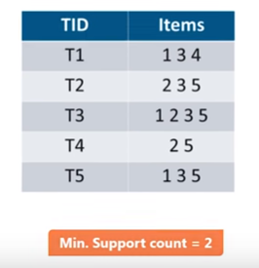
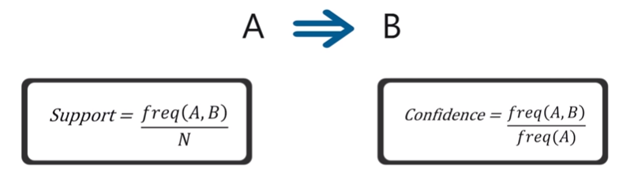
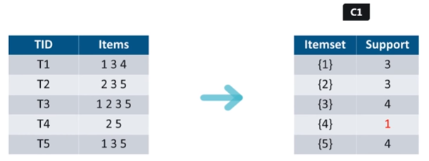
Working of Association rule Mining

Slide 10
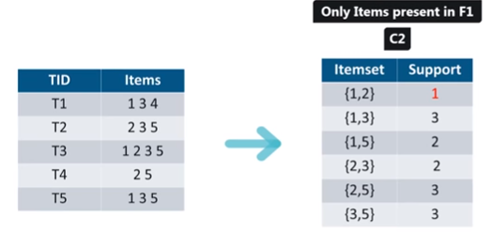
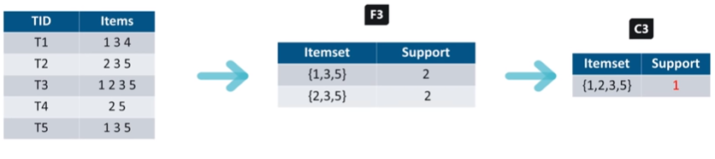
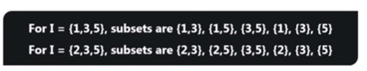
Fig 1.5

Slide 11
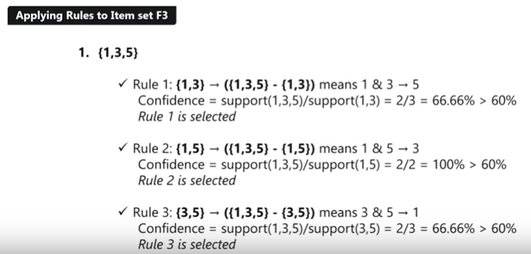
Applying Association rules to the Selected items.

Slide 12
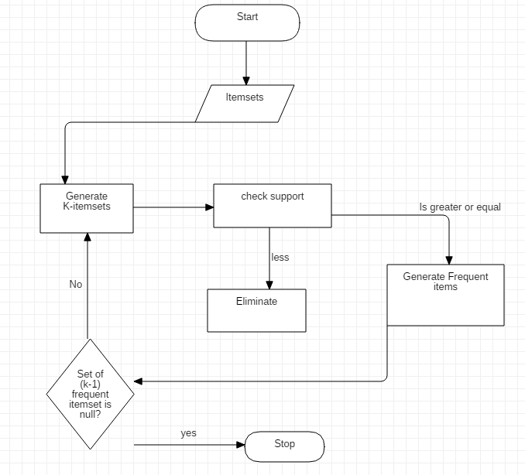
Flow Chart

Slide 13
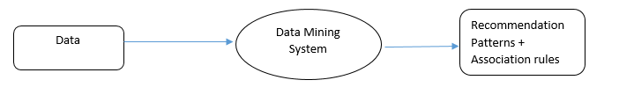
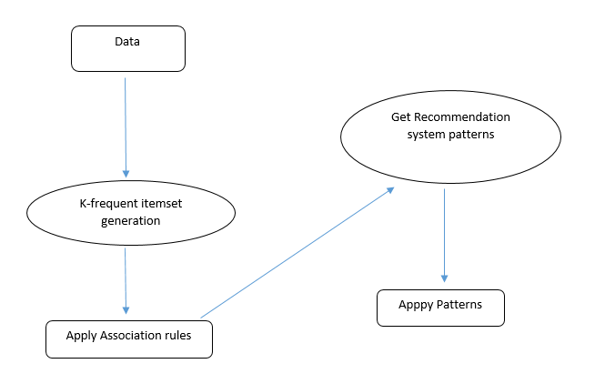
Data-Flow Diagram (Level 0)
(Level 1)

Slide 14
• Frequent Itemsets: All the sets which contain the item with the minimum support (denoted by 𝐿𝑖 for 𝑖 𝑡ℎ itemset). • Apriori Property: Any subset of frequent itemset must be frequent. • Join Operation: To find 𝐿𝑘, a set of candidate k-itemsets is generated (Ck) by joining 𝐿𝑘−1 with itself. • Prune Step: Any (k-1)-itemset that is not frequent cannot be a subset of a frequent k-itemset
KEY CONCEPTS

Slide 15
The Apriori Algorithm : Pseudo Code
• Join Step: 𝐶𝑘 is generated by joining 𝐿𝑘−1 with itself
• Prune Step: Any (k-1)-itemset that is not frequent cannot be a subset of a frequent k-itemset
• Pseudo-code :
𝐶𝑘: Candidate itemset of size k
𝐿𝑘: frequent itemset of size k
L₁ = {frequent items};
For (K=1; L_{k}! = ϕ; k++) do begin
C_{k+1} = candidate generated from L_{k}; // join
For each transaction t in database do
Increment the count of all candidates in C_{k+1}
Those are contained in t
L_{k+1} = candidate in C_{k+1} with min_support //prune
End
Return L_{k-1}; when L_{k}=ϕ

Slide 16
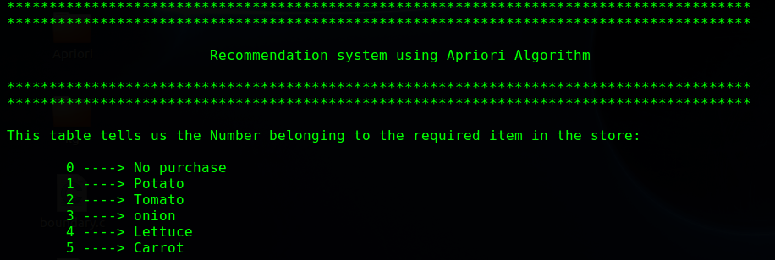
Output Screens
This is the First Screen that tells you the Data item list

Slide 17
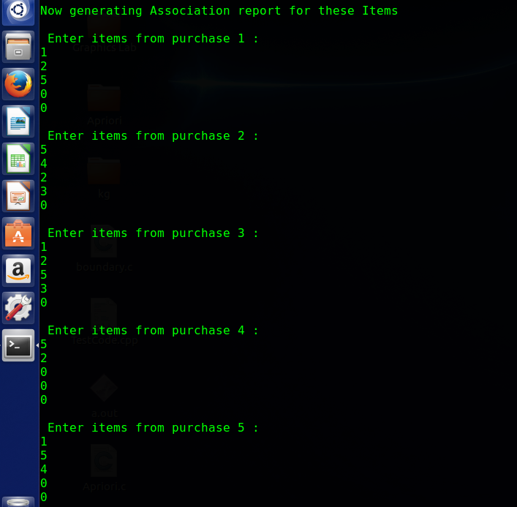
This Screen Accepts the transactions from the admin to generate patterns.

Slide 18
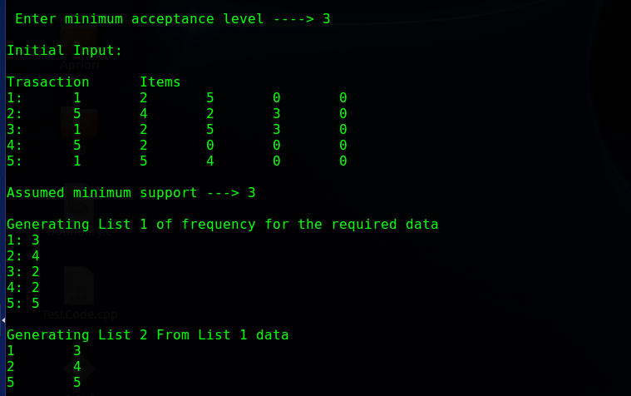
Here we accept the Acceptance level (support value) and the initial input is displayed with the first list (C1) of item including their frequencies and list2 (L1) is also generated from list1 with the applied rule of support value(PRUNE STEP).

Slide 19
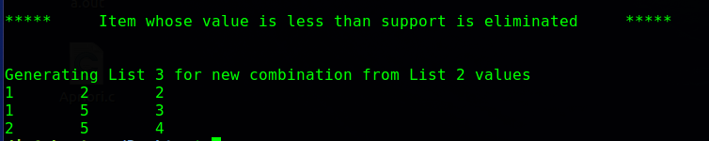
The final list shows the List 3 (C2) generated from the output of list 2.

Slide 20
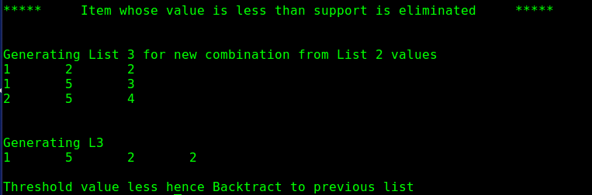
The final list shows the List 4 generated from the output of list 3.

Slide 21
Why Apriori Algorithm?
This is the most simple and easy-to-understand algorithm among association rule learning algorithms
The resulting rules are intuitive and easy to communicate to an end user
It doesn't require labeled data as it is fully unsupervised; as a result, you can use it in many different situations because unlabelled data is often more accessible
The algorithm is exhaustive, so it finds all the rules with the specified support and confidence.

Slide 22
Future Enhancements
Transaction reduction: A transaction that does not contain any frequent k-itemsets is useless in subsequent scans.
Partitioning: Any itemset that is potentially frequent in DB must be frequent in at least one of the partitions of DB.
Dynamic itemset counting: add new candidate itemsets only when all of their subsets are estimated to be frequent

Slide 23
Motivation
A host of technological advances have resulted in generating a huge amount of electronic data, and have enabled the data to be captured, processed, analyzed, and stored rather inexpensively.
The need to understand huge, complex, information-rich data sets is important to virtually all fields in business, science and engineering.
The ability to extract useful knowledge hidden in these data and to act on that knowledge is becoming vital in today’s increasingly competitive world. Such data (typically terabytes in size) is often stored in data warehouses and data marts.

Slide 24
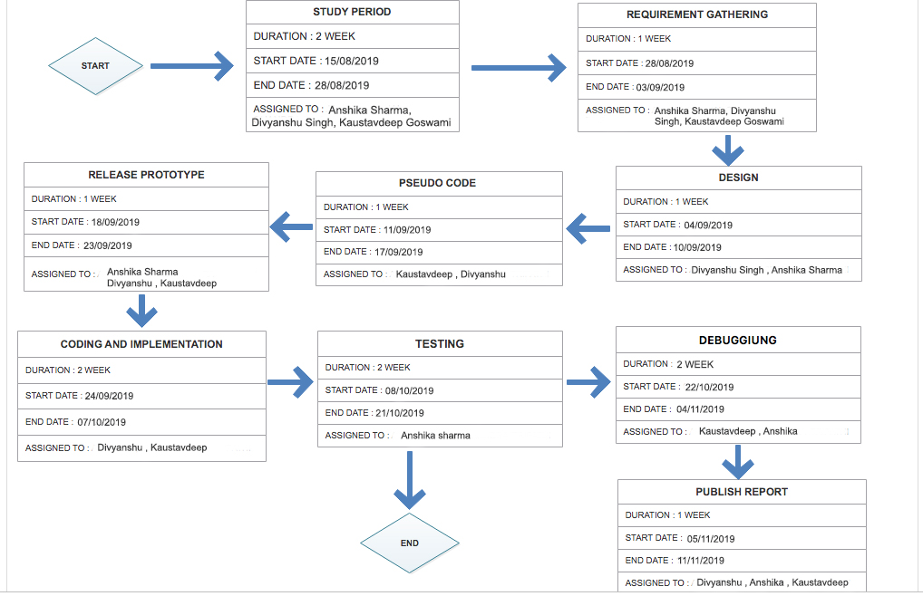
SCHEDULE

Slide 25
Conclusion
Apriori algorithm effectively generates highly informative frequent itemsets and association rules for the Market Stores. Market Stores widely used the market basket analysis to manage the placement of goods in their store layout.
Related products are placed together in such a manner that customers can logically find items he/she might buy which increases the customer satisfaction and hence the profit.
From the results it is shown that the market basket analysis using Apriori algorithm for Market stores improves its overall revenue.

